Slide 1

A RUNTIME AND STRUCTURAL CHARACTERIZATION OF THE BENCHMARK QUERIES IN TPC-H
By Bhavitha Sanikommu & Kobe Richards

Slide 2
INTRODUCTION
Why Benchmarking Matters
Standardized way to compare DBMS performance
TPC benchmarks define realistic, repeatable workloads
Why TPC-H?
Long-standing benchmark for analytical and decision-support workloads
Simple schema, but complex queries
Ideal for studying real optimizer and execution-engine behavior
Still widely used in research and industry despite newer alternatives

Slide 3
PROJECT GOAL
Analyze all 22 TPC-H queries from both a runtime and structural perspective.
Identify:
Fastest vs. slowest queries
Outliers & consistent patterns
Structural reasons behind performance differences
Compare findings to known TPC-H choke points.
Understand how query composition shapes DBMS behavior.

Slide 4
BACKGROUND
TPC-H Overview
8 tables, normalized schema
22 analytical SQL queries
Dbgen/qgen for scalable & parameterized workloads
What Makes TPC-H Complex?
Multi-way joins
Heavy aggregation
Correlated subqueries
No precomputed summaries
Tests join ordering, cardinality estimation, & memory behavior

Slide 5
RELATED WORK – OTHER BENCHMARKS
Overview of Decision Support Benchmarks (Barata et al.)
TPC-DS: large schema, 99 queries, very complex OLAP workloads
SSB: simplified star schema, derived from TPC-H, easier to implement but still OLAP-focused
Why TPC-H is Still Used
Simpler schema and smaller query set
Still exercises core OLAP operations (join, aggregates, filters)
Remains a standard baseline in papers and systems comparisons

Slide 6
RELATED WORK – CHOKE POINTS
TPC-H Analyzed (Boncz et al.)
Identifies 28 choke points:
Hard join ordering
Correlated subqueries
Large aggregations
Poor data locality
Quantifying Choke Points (Dreseler et al.)
Optimizations have huge impact:
Subquery flattening 🡪 5x speedups
Predicate pushdown 🡪 significantly smaller intermediates

Slide 7
RELATED WORK – TPC-H VARIANTS
Adding a Temporal Dimension (Al-Kateb et al.)
Adds valid-time & transaction-time columns
Temporal joins get more expensive
Introducing Skew (Crolette et al.)
Injects realistic or synthetic data skew
Exposes optimizer instability & load imbalance
Reduced TPC-H Benchmark (Vandierendonck et al.)
5-6 query subsets can approximate full benchmark
PCA shows many queries are redundant

Slide 8
METHODS
Database Environment
SQLite v3.x with TPC-H benchmark (SF1, ~1GB): 8 tables from 5 to 6M rows
Primary key constraints only; SSD storage; cold-start measurements (OS cache cleared)
Execution & Analysis
All 22 queries run 3× with median time recorded; structural analysis via EXPLAIN QUERY PLAN
Optimization applied to slowest queries (Q17, Q20, Q22): CTE-based subquery elimination, join flattening, predicate reorganization with result verification

Slide 9
RESULTS

Slide 10
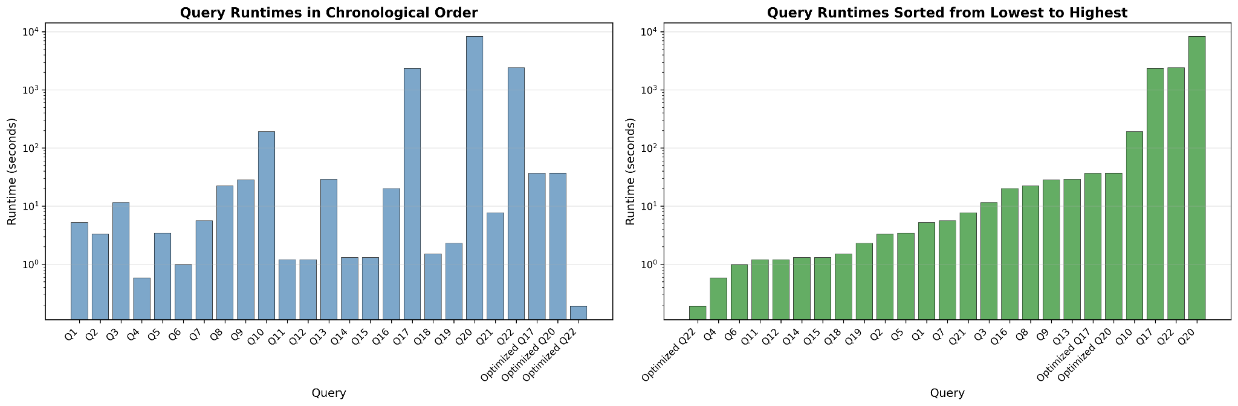
QUERY RUNTIME ANALYSIS
Runtimes for all TPC-H queries, shown in numerical order (left) and sorted from fastest to slowest (right). Both plots use a log-scale y-axis to highlight the wide spread in execution times and the sharp separation between typical queries and the slowest outliers.

Slide 11
QUERY OPTIMIZATIONS
Query | Original Runtime (sec) | Optimized Runtime (sec) | Speedup
Q17 | 2334 | 36.8 | 62.5x
Q20 | 8304 | 36.9 | 232x
Q22 | 2413 | 0.19 | 12632x
Original versus optimized runtimes of the three slowest queries, showing the impact of subquery flattening and restructuring on execution time.

Slide 12
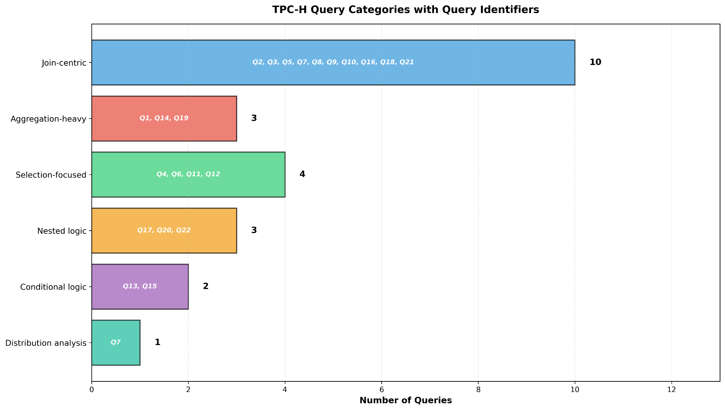
STRUCTURAL CLASSIFICATION
Structural classification of the 22 TPC-H queries, grouped by dominant query type and labeled by query ID.

Slide 13
CHOKE POINT INTERPRETATION
Choke Point 1: Correlated Subqueries (Q17, Q20, Q22)
O(n²) nested-loop evaluation; Q22: 2,400s → 0.19s (12,632× speedup) via correlation elimination
Tests subquery decorrelation capability; principle: compute once, use many times
Choke Point 2: Join Order Selection (10 queries with 3-8 table joins)
5-10× variance from selective filter placement; tests cost-based join enumeration
Choke Point 3: Aggregation Efficiency (Q1, Q6, Q12, Q14, Q19)
Fast baseline (<10s) with 2-10× system differences; reflects vectorized execution and OLAP vs OLTP optimization

Slide 14
CONCLUSION
Key Findings
500× runtime spread (1s to 2+ hours) demonstrates TPC-H effectively discriminates database sophistication
Three choke points: correlated subqueries (62.5-12,632× speedup), join ordering (5-10×), aggregation (2-10×)
Query structure often matters more than data volume
Implications
Practitioners: Check correlated subqueries first when debugging slow queries
Researchers: Separate optimizer sophistication testing from raw execution speed
TPC-H remains relevant by testing fundamental capabilities that vary widely across systems

Slide 15
THANKS FOR LISTENING

